Slide 1
POLARIZATION
Dr. Aarti Sharma

Slide 2


Polarized Lens on a Camera

Slide 3
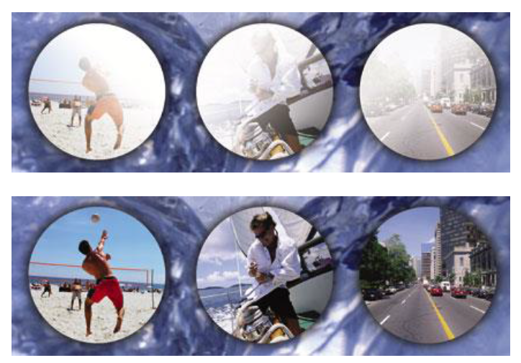
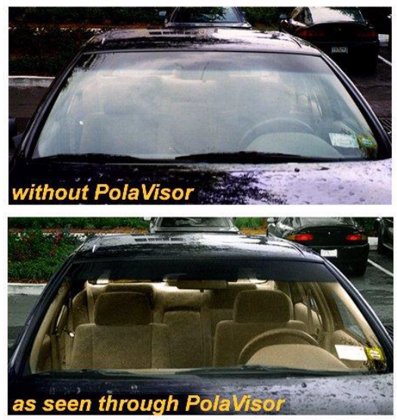
Polarized Lens on a Camera

Slide 4
POLARIZATION OF LIGHT
The ordinary light consist of transverse waves in which vibrations takes place symmetrically in all directions in a plane perpendicular to the direction of propagation of light. When such light passes through a thin crystal plate A, its vibration are confined only to a single line in a plane perpendicular to the direction of propagation of light. The light which exhibit the property of one sidedness is called polarized light or the phenomenon of asymmetry of vibrations about the direction of propagation is called polarization of light.
Light which has acquired the property of one-sidedness is called POLARIZED LIGHT.
The phenomena of asymmetry of vibrations about the direction of propagation is called POLARIZATION
OR
The process of removing the symmetry and bringing in one-sidedness is called POLARIZATION.

Slide 5
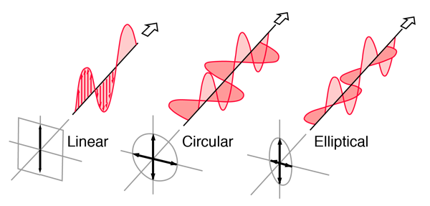
Types of polarization
When the vibrations are confined along a single direction at right angles to the direction of propagation the light is said to be PLANE POLARIZED.
If the vibrations are along a circle it is called CIRCULARLY POLARIZED LIGHT.
If the vibrations are along an ellipse it is called ELLIPTICALLY POLARIZED LIGHT.

Slide 6
Electromagnetic Theory Of Light And Polarization
The electromagnetic waves emitted by any common source of light (such as the Sun or a bulb) are polarized randomly, or unpolarized (the two terms mean the same thing).That is, the electric field at any given point is always perpendicular to the direction of travel of the waves but changes directions randomly.
EMR has periodic electric and magentic vibrations in mutually perpendicular plane at right angles to the direction of wave propagation.
Polarization :Electromagnetic waves are polarized if their electric field vectors are all in a single plane, called the plane of oscillation. Light waves from common sources are not polarized; that is, they are unpolarized, or polarized randomly.

Slide 7
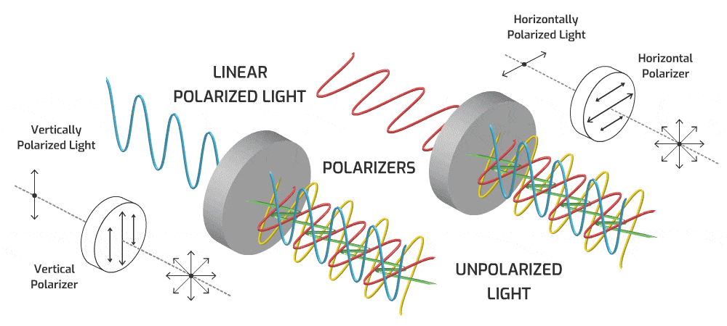

Linearly Polarized Light

Slide 8
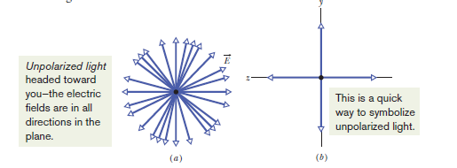
Representation of unpolarized wave and polarized wave

Slide 9
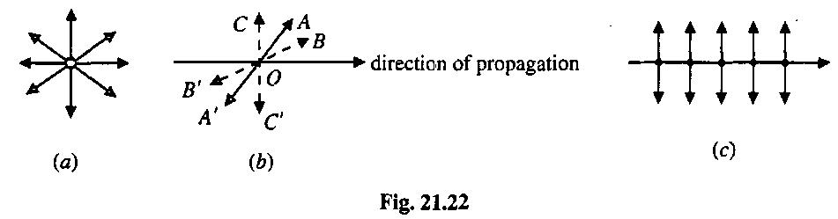
Comparison between unpolarized and polarized light
Unpolarized Light
Polarized Light
The light waves that have vibrations occurring within them at random angles without any plane.
The phase difference does not exist, and the changes in the electric field take place at random speeds.
Produced by conventional light sources.
It is represented by
The light waves that have vibrations occurring within them in a single plane.
The x– and y– components connected to the electric field have a constant phase difference between them.
Is to be obtained from unpolarized light with the help of polarizers
It is represented by

Slide 10
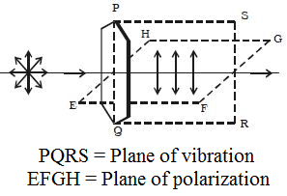
Plane of Polarization
The plane of polarization is the plane perpendicular to the plane of vibration which contains the direction of propagation of light but no vibrations at all. It is shown in the figure.

Slide 11
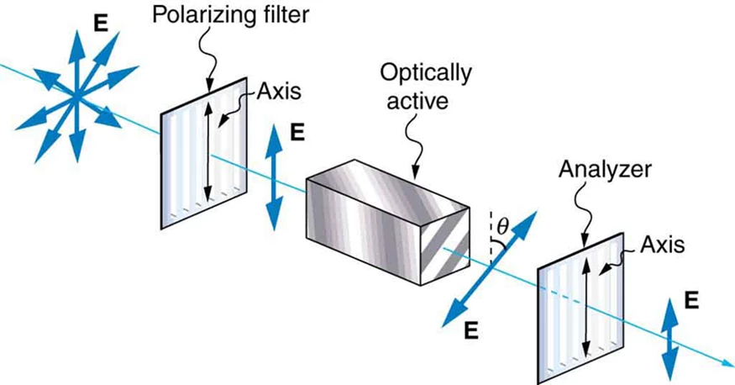
MALUS’ LAW (Intensity of light transmitted by analyzer)
When completely plane polarized light is incident on the
analyzer, the intensity I of the light transmitted by the analyser
is directly proportional to the square of the cosine of angle
between the transmission axes of the analyzer and the polarizer.
I ∞ cos²θ

Slide 12
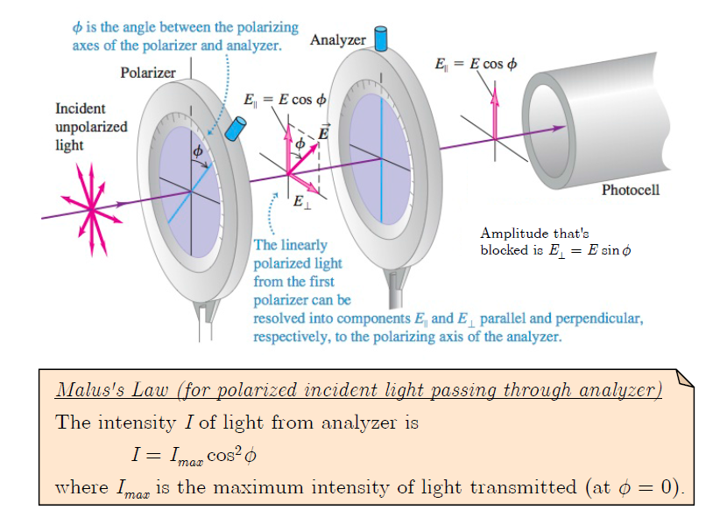

Slide 13
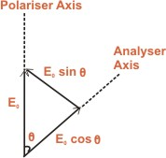
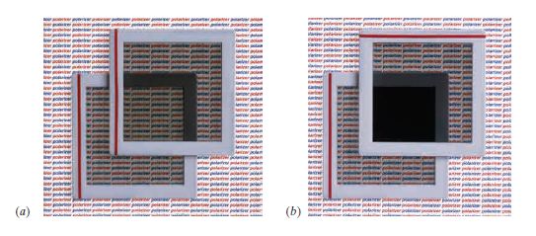
Suppose the angle between the transmission axes of the analyzer and the polarizer is θ.
The completely plane polarized light form the polarizer is incident on the analyzer.
If E₀ is the amplitude of the electric vector transmitted by the polarizer, then intensity I₀ of the light incident on the analyzer is I ∞ E₀²
The electric field vector E₀ can be resolved into two rectangular components i.e E₀ cosθ and E₀sinθ.
The analyzer will transmit only the component ( i.e E₀cosθ ) which is parallel to its transmission axis.
However, the component E₀sinθ will be absorbed by the analyser.
Therefore, the intensity I of light transmitted by the analyzer is,
I ∞ ( E₀ cosθ )²
I / I₀ = ( E₀ cosθ )² / E₀² = cos²θ
I = I₀ cos²θ
Therefore, I ∞ cos²θ.
When θ = 0° ( or 180° ), I = I₀ cos²0° = I₀
That is the intensity of light transmitted by the analyzer is maximum when the transmission axes of the analyzer and the polarizer are parallel.
When θ = 90°, I = I₀ cos²90° = 0.
That is the intensity of light transmitted by the analyzer is minimum when the transmission axes of the analyser and polarizer are perpendicular to each other.

Slide 14
PRODUCTION OF POLARZED LIGHT
Plane polarized light may be produced from unpolarised light using the following optical phenomena:
Reflection
Double refraction
Scattering
Selective absorption

Slide 15
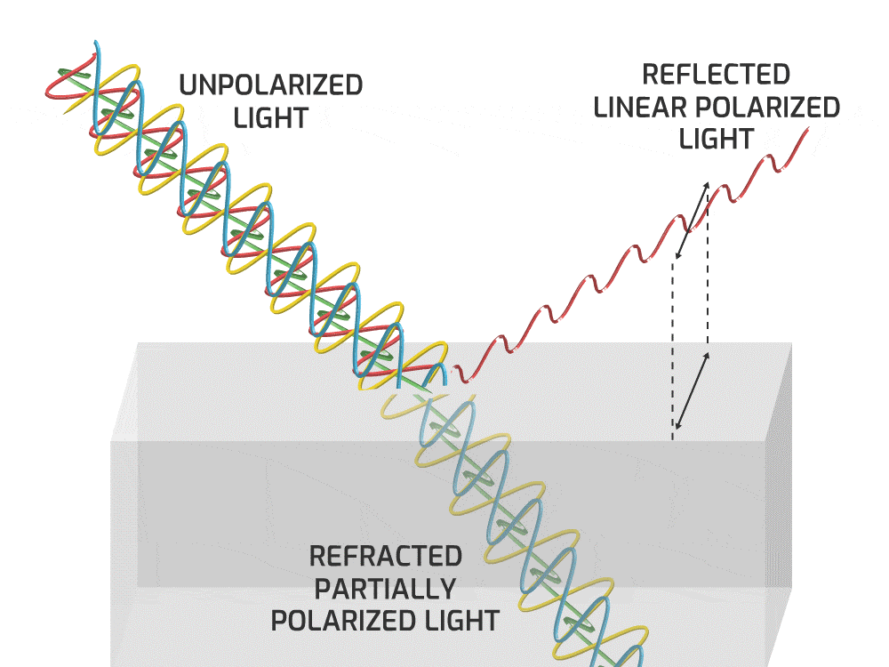
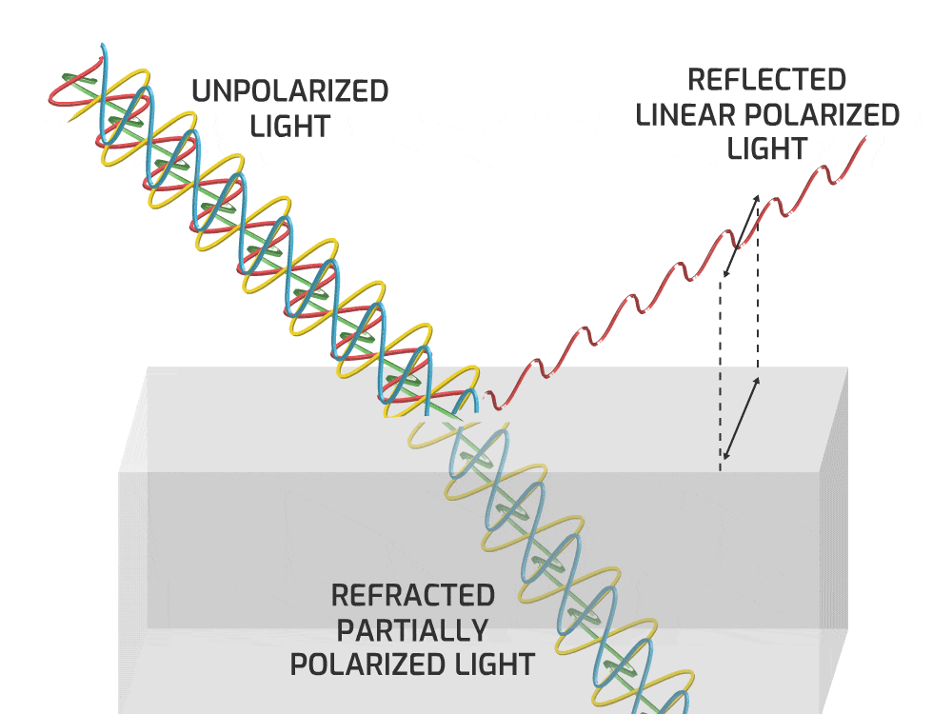
Polarization by Reflection
In the process of polarization by using reflection of light phenomenon, the unpolarized light is reflected from the non metallic surface.
The amount of polarization then will depend on the angle of incidence of the light and the composition of the material used for the reflecting surface.
Malus discovered that when a beam of ordinary light is reflected from the surface of transparent media like glass or water, it gets polarized. The degree of polarization varies with angle of incidence.

Slide 16
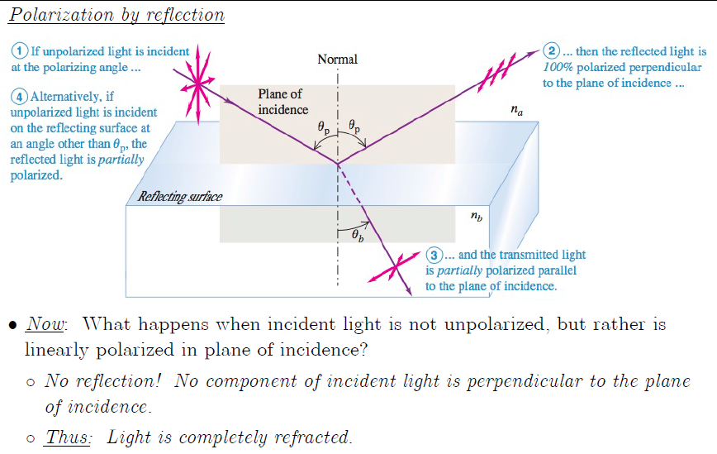

Slide 17
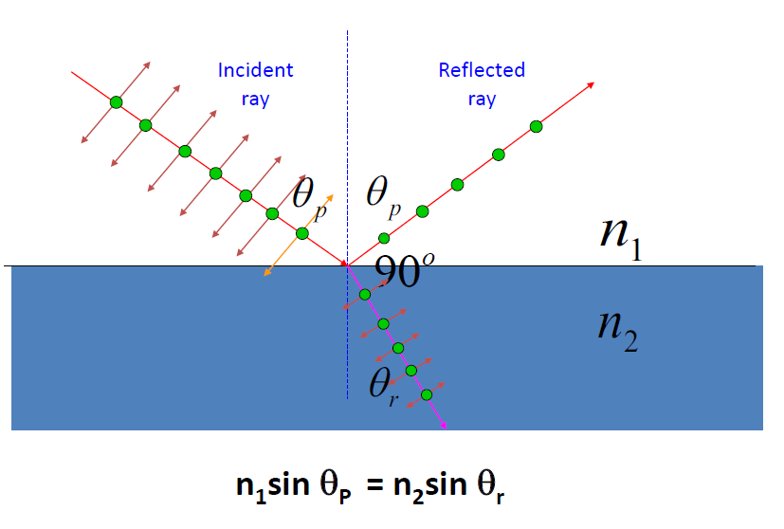
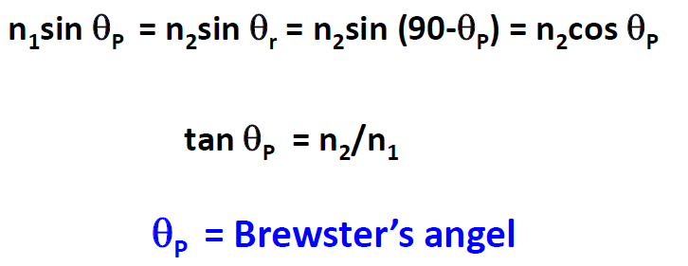

Slide 18
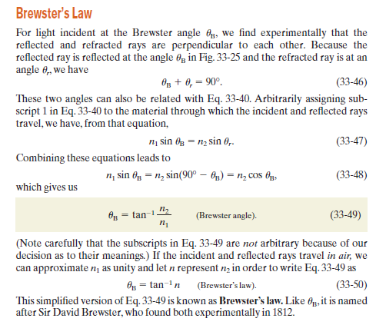

Slide 19
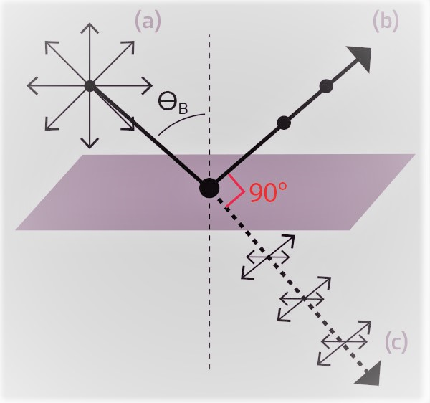
In polarization by reflection, when the light is allowed to be incident at a particular angle, (for glass it is 57.5º) the reflected beam is completely plane polarised. The angle of incidence at which the reflected beam is completely plane polarised is called the polarising angle (i_{p}).
The polarising angle (i_{p}) is given as
θ= θ_{p} = tan⁻¹ (n₂ / n₁), where n₁ and n₂ are the refractive indices of rare and denser medium respectively.
Thus if unpolarized beam is incident at this angle, then the reflected beam will be linearly polarized with its electric vector perpendicular to the plane of incidence.
Above equation is also referred to as the Brewster’s law.
At this angle of incidence, the reflected and transmitted rays are at right angles to each other.
Thus angle θ_{p} is known as polarizing angle or Brewster’s angle.

Slide 20
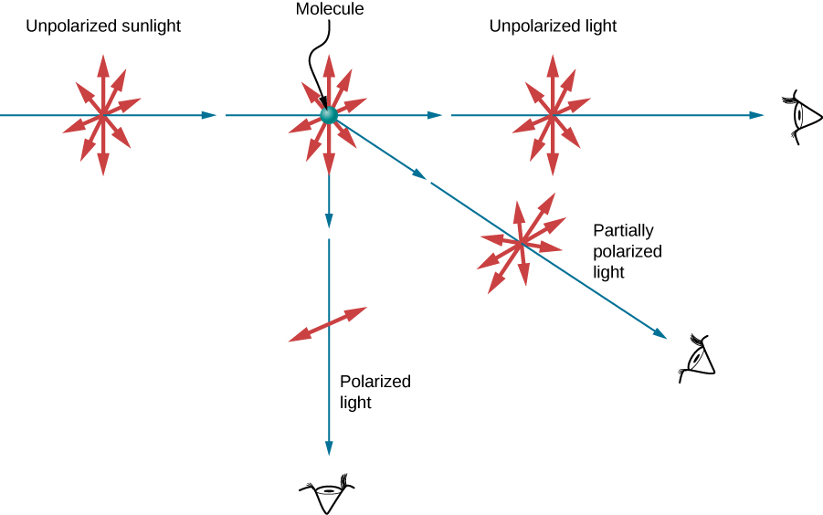
Polarization by Scattering
Since light is a transverse EM wave, it vibrates the electrons of air molecules perpendicular to the direction that it is traveling.
The electrons then radiate like small antennae.
Since they are oscillating perpendicular to the direction of the light ray, they produce EM radiation that is polarized perpendicular to the direction of the ray.
When viewing the light along a line perpendicular to the original ray,

Slide 21
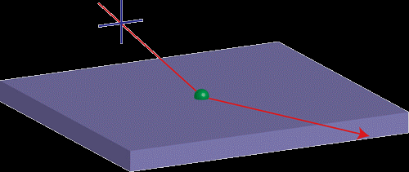
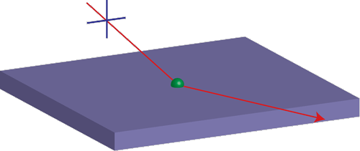

Slide 22
The light wave radiated from the sun is unpolarised. Once it reaches the Earth’s atmosphere it undergoes scattering. As they are transverse in nature, They vibrate air molecules perpendicular to the direction of their propagation. As a result, electrons in the air molecules starts emitting radiation in the form of light in many directions. Refer to Figure for better visualization. These light are polarized in the direction perpendicular to the direction of propagation of the original ray.
The emitted rays of light which are parallel to the direction/orientation of original rays are completely unpolarised.
The emitted rays of light which are perpendicular to the direction of original rays are completely polarized.
The rays of light which are scattered in all other directions are partially polarised.

Slide 23
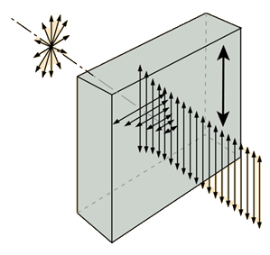
Polarization by Selective Absorption
A number of crystalline materials absorb more light in one incident plane than another, so that light progressing through the material become more and more polarized as they proceed. This anisotropy in absorption is called dichroism. There are several naturally occurring dichroic materials, and the commercial material polaroid also polarizes by selective absorption.

Slide 24
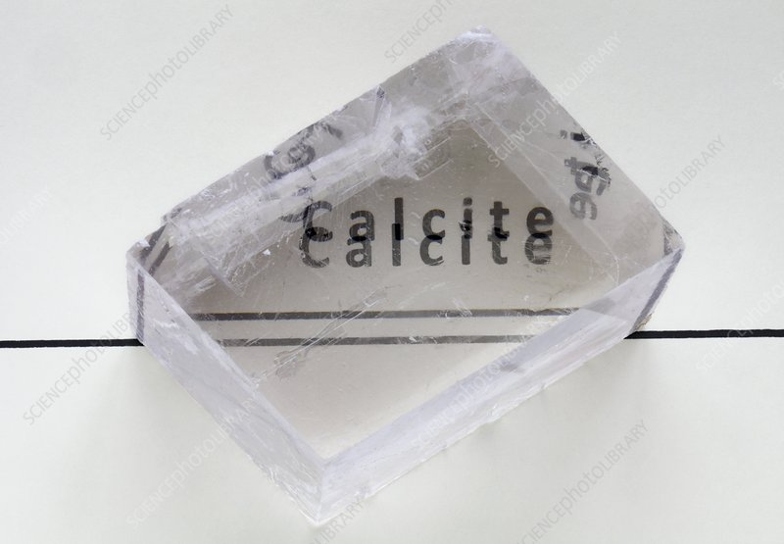
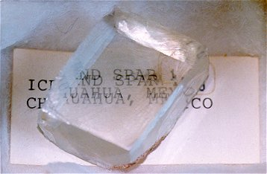
Polarization by Double Refraction (Bi-refringence)
Some transparent crystals, such as calcite and quartz, have the property that when one views an object through them one sees two images of the object.
If one passes a narrow beam of light through them, the refracted beam is split into two parts which travel through the crystal and emerge as two separate beams.
One of the beams obeys the ordinary laws of refraction (Snell’s Law) and is called the ordinary ray (o-ray). The other beam is called the extraordinary ray (e-ray).

Slide 25
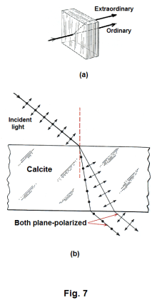
If one analyzes the two beams with a Polaroid analyzer, one discovers that the two beams are both polarized, but that the directions of their vibrations are at right angles to each other

Slide 26
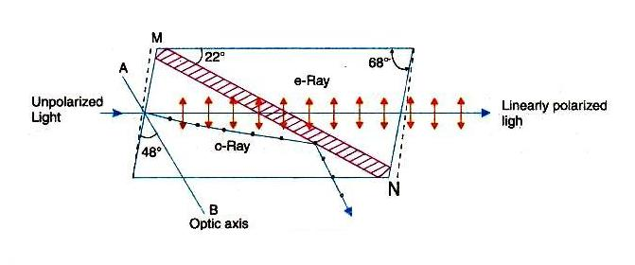
Nicole Prism
A Nicol prism is made from calcite crystal.
It was designed by William Nicol in 1820.
A calcite crystal whose length is three times as its width
The end faces of this crystals are grounded in such a way that the angles in the principal section becomes 68⁰ and 112⁰ instead of 71⁰ and 109⁰
The crystal is cut in two pieces by a plane perpendicular to the principal section as well as the new end faces.
The two parts of the crystal are then cemented together with Canada balsam.
The refractive index of Canada balsam lies between the refractive indices for the ordinary and extra-ordinary rays for calcite.

Slide 27
An optic axis of a crystal is a direction in which a ray of transmitted light suffers no birefringence (double refraction). An optical axis is a direction rather than a single line: all rays that are parallel to that direction exhibit the same lack of birefringence.

Slide 28
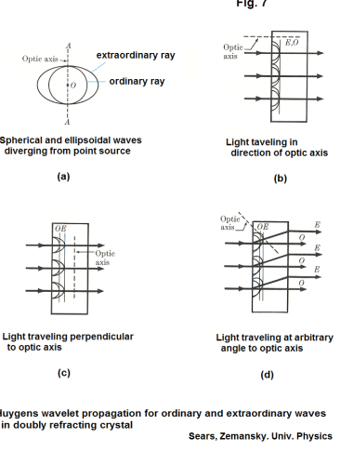

Slide 29
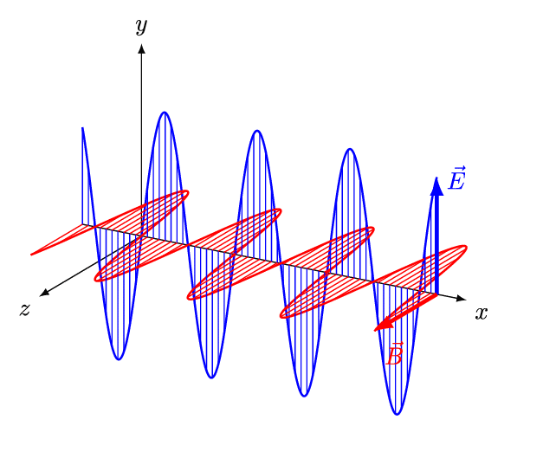

Types of polarization
Linear Polarization
A plane electromagnetic wave is said to be linearly polarized. The transverse electric field wave is accompanied by a magnetic field wave as illustrated.

Slide 30
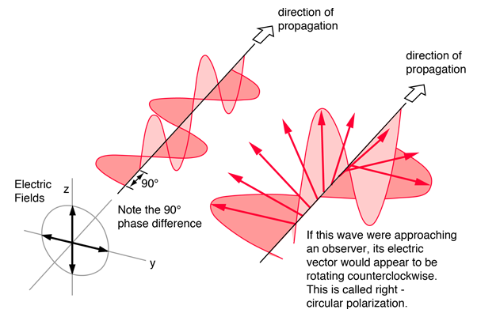
Circular Polarization
Circularly polarized light consists of two perpendicular electromagnetic plane waves of equal amplitude and 90° difference in phase. The light illustrated is right- circularly polarized.

Slide 31
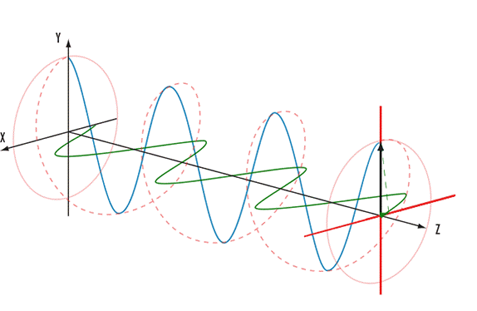
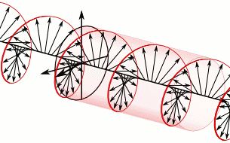
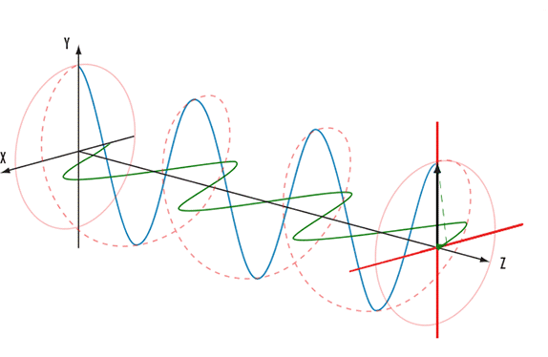


Slide 32
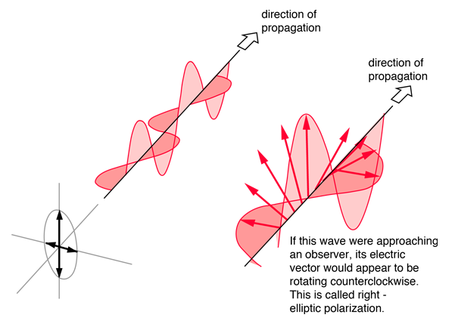
Elliptical Polarization
Elliptically polarized light consists of two perpendicular waves of unequal amplitude which differ in phase by 90°. The illustration shows right- elliptically polarized light.

Slide 33
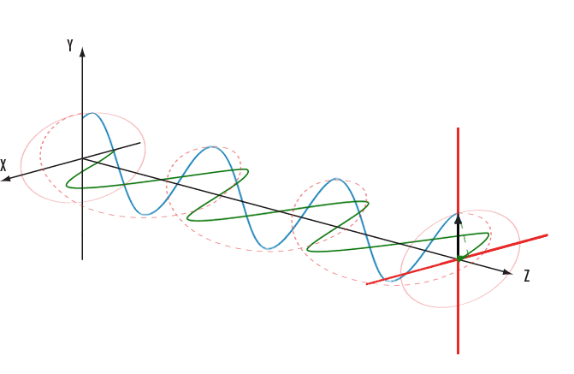


Slide 34
Circular Polarization
Circularly polarized light consists of two perpendicular electromagnetic plane waves(E_{x} and E_{y}) of equal amplitude and 90° difference in phase. The light illustrated is right- circularly polarized. If light is composed of two plane waves of equal amplitude but differing in phase by 90°, then the light is said to be circularly polarized. If you could see the tip of the electric field vector, it would appear to be moving in a circle as it approached you. If while looking at the source, the electric vector of the light coming toward you appears to be rotating counterclockwise, the light is said to be right-circularly polarized. If clockwise, then left-circularly polarized light. The electric field vector makes one complete revolution as the light advances one wavelength toward you. Another way of saying it is that if the thumb of your right hand were pointing in the direction of propagation of the light, the electric vector would be rotating in the direction of your fingers.

Slide 35
The phase shift can be introduced by use of a material that exhibits birefringence—that is, has different indexes of refraction for different directions of polarization. A common example is calcite , when a CaCO₃, calcite crystal (Nicol Prism) is oriented appropriately in a beam of unpolarized light, its refractive index (for a wavelength in vacuum of 589 nm) is 1.658( lets say for E_{x} component) for one direction of polarization and 1.486(E_{y} component)for the perpendicular direction.

Slide 36
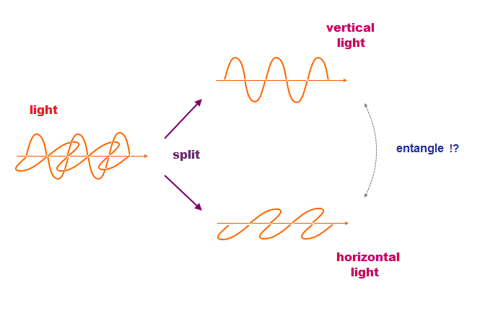
Concept of production of polarized beam of light from two SHM
acting at right angle
When the ordinary and extraordinary rays in a doubly refracting crystal are separated, each ray is linearly polarized, but with the directions of vibration at right angles.

Slide 37
Since an ordinary ray the direction of vibration is perpendicular to that in the extraordinary ray, we have to consider the following question.
What sort of vibration results from the combination of two simple harmonic vibrations at right angles to each other and differing in phase?

Slide 38
Two simple harmonic motions at right angles to each other never produce destructive interference, no matter what the phase difference.

Slide 39
When, however, the crystal is cut with its faces parallel to optic axis, so that light, incident normally on one of the faces, transverse the crystal in a direction perpendicular to the optic axis, as shown in fig.
The ordinary and extraordinary rays are not separated. They traverse the same path, but with different speeds.
Upon emerging from the second face of the crystal, the ordinary and the extraordinary rays are out of phase with each other and give rise to either elliptically polarized, circularly polarized or linearly polarized light, depending on sample thickness.

Slide 40
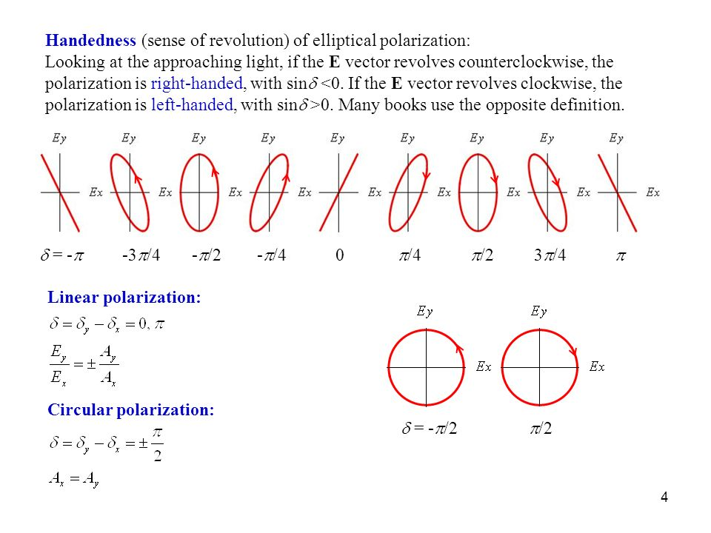
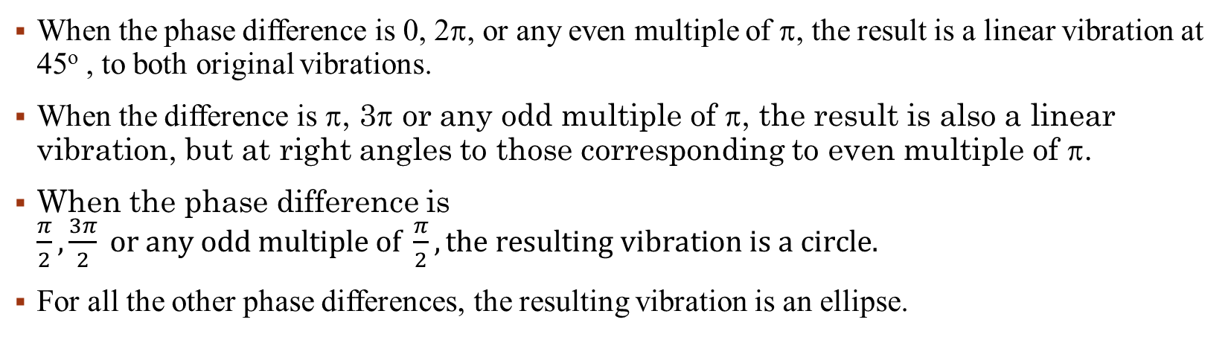
When the phase difference is 0, 2, or any even multiple of , the result is a linear vibration at 45º , to both original vibrations.
When the difference is , 3 or any odd multiple of , the result is also a linear vibration, but at right angles to those corresponding to even multiple of .
When the phase difference is $\frac{π}{2}, \frac{3π}{2} or any odd multiple of \frac{π}{2}, the resulting vibration is a circle.$
For all the other phase differences, the resulting vibration is an ellipse.

Slide 41
Polariscope
The experimental procedure relies on the property of birefringence, as exhibited by certain transparent materials. Birefringence is a phenomenon in which a ray of light passing through a given material experiences two refractive indices. The property of birefringence (or double refraction) is observed in many optical crystals. Upon the application of stresses, photoelastic materials exhibit the property of birefringence, and the magnitude of the refractive indices at each point in the material is directly related to the state of stresses at that point. Information such as maximum shear stress and its orientation are available by analyzing the birefringence with an instrument called a polariscope.
When a ray of light passes through a photoelastic material, its electromagnetic wave components are resolved along the two principal stress directions and each component experiences a different refractive index due to the birefringence. The difference in the refractive indices leads to a relative phase retardation between the two components.

Slide 42
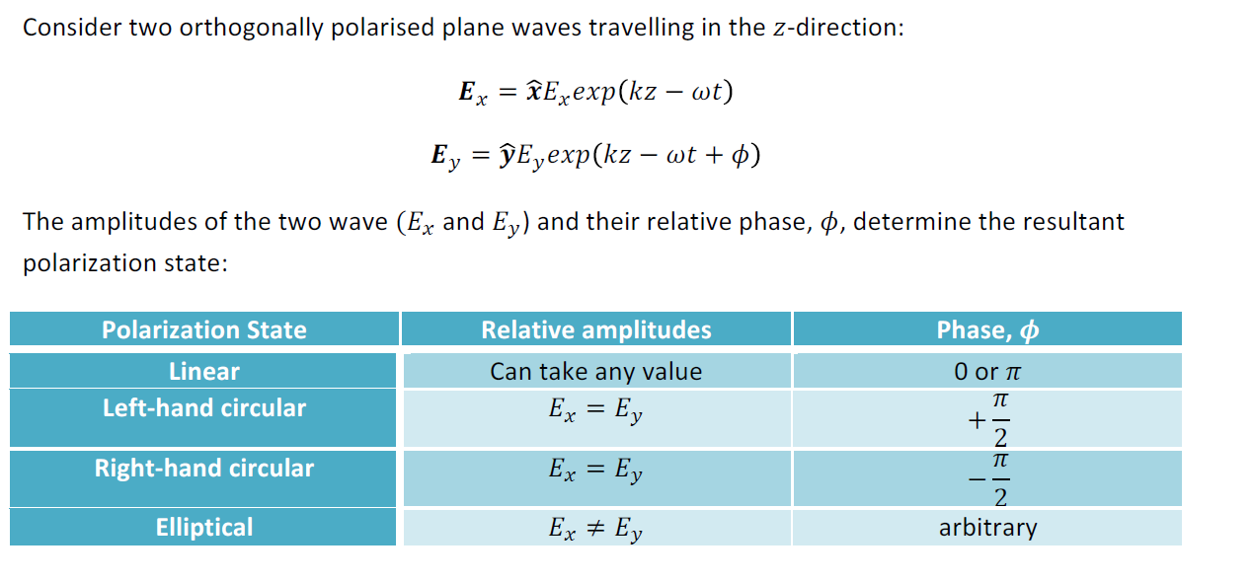
Mathematics of Circular and Elliptical Polarization
Consider two orthogonally polarized plane waves travelling in the z-direction:
E_{y} = E₁ cos (kx – ωt)
E_{x} = E₂ cos (kx – ωt + ϕ)
The amplitudes of the two waves (E_{x} and E_{y}) and their relative phase ϕ, determine the resultant polarization state:

